Slide 1


Dancers for Resilience
Your studio has an audience, a community, and a stage.
That's exactly what Ukraine needs right now.
Impact & Inspiration
UKRAINIANPATRIOT.ORG

Slide 2
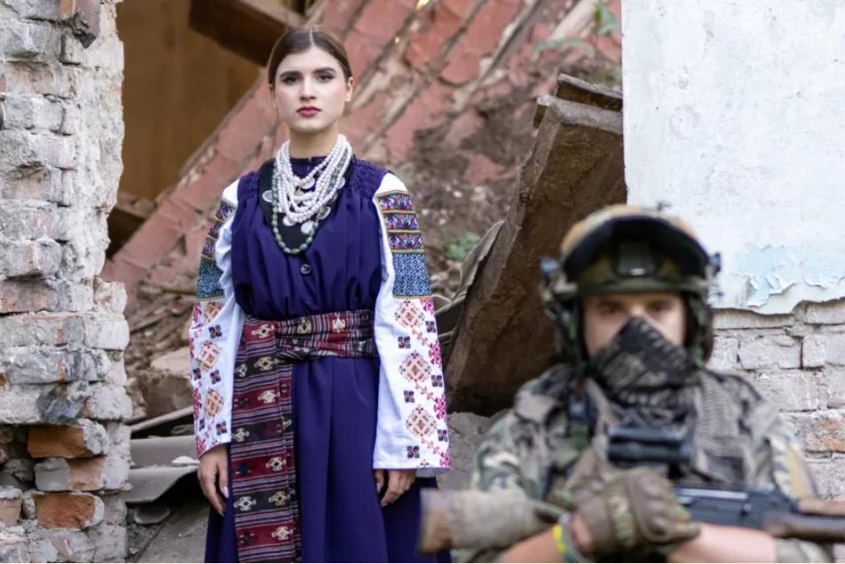
WHO WE ARE
Built by a dancer. Driven by what's possible.
Ukrainian Patriot was founded in 2022 by Lana Nicole Niland — a former professional dancer who was in her home in Kyiv when the war began and chose to act. What started as emergency aid has grown into a grassroots organisation running regular missions to the frontline: bringing supplies, medical support, and dance to communities who haven't left.
In four+ years, we've reached thousands of people on the ground. Every one of them because someone decided to move.
Culture and aid aren't separate things.
Frontline Dance Collective
UKRAINIANPATRIOT.ORG

Slide 3
HUMANITARIAN AID
MEDICAL SUPPLIES AND EQUIPMENT
PROTECTIVE GEAR
MENTAL HEALTH AND PTSD RECOVERY
REBUILDING ASSISTANCE
We provide food, hygiene kits, warm clothing, and thermal blankets to people living in frontline and recently liberated areas. Every food bag is packed with fresh produce, tinned goods, and a personal touch.
We support hospitals, medics, and defenders with critical items such as personal protective equipment, wound dressings, mobility aids, and hospital beds.
We equip civilians, medics, and defenders with
essential items like helmets and protective vests to help save lives in high-risk areas.
We help restore homes, community spaces, and schools affected by the war. Through education, training, and psychological
support, we are also rebuilding lives and
strengthening the
foundations for a resilient future.
We deliver trauma-
informed programmes that include art and dance as therapy, children’s resilience camps, and community healing sessions.
Our strength lies in our trusted network of Points of Contact (POCs) embedded in local communities. This allows us to assess needs quickly, respond effectively, and ensure every donation makes a real difference. UP is not a large impersonal organisation. We are a dedicated team rooted in compassion, committed to acting with integrity, transparency, and respect.
Ukrainian Patriot is not only rebuilding what was lost — we are laying the foundations of hope and recovery, grounded in light, love, hope, and connection.
UKRAINIANPATRIOT.ORG

Slide 4
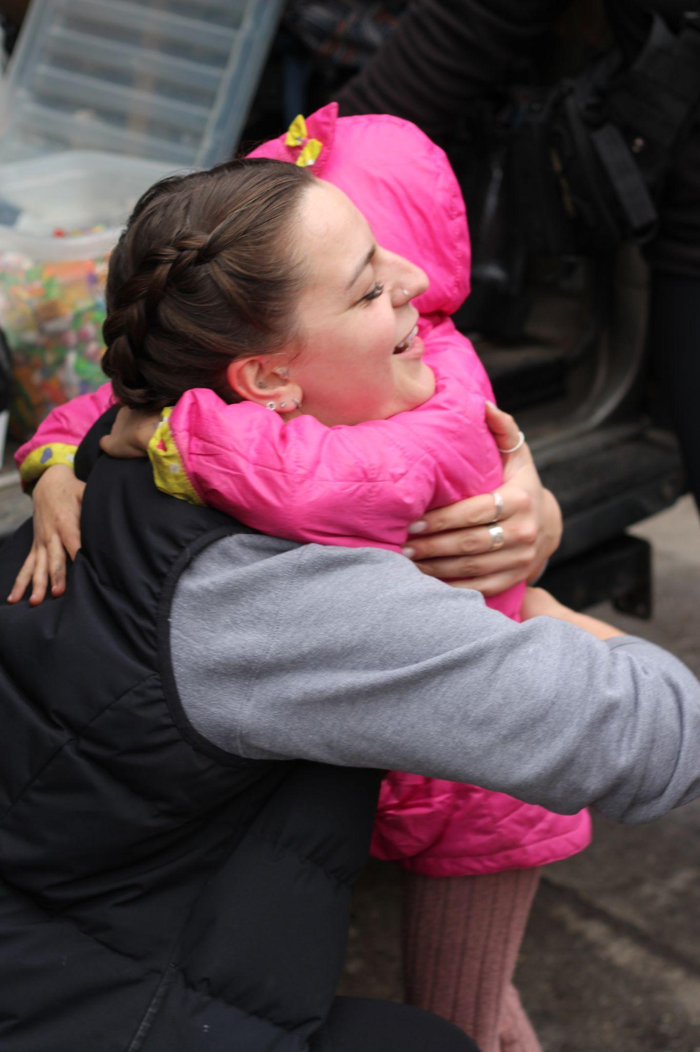
When war tries to silence music and movement, dance becomes a lifeline.
Ukrainian Patriot is moving to connect dancers across the world to stand with us in bringing hope, healing, and connection to Ukraine’s hardest hit communities.
Every step is defiance; every move is survival. Each beat carries the story of our people.
We dance beside, listen closely, and hold tight to those we serve.
UKRAINIANPATRIOT.ORG

Slide 5
THE CAMPAIGN
Your school's challenge.
Each participating dance group chooses one month of the year to raise a minimum of $500 in support of Ukrainian Patriot's life-changing work in Ukraine.
Not everyone can stand on the frontlines like our team, many of whom are dancers. But you can be just as effective in your studio as they are in the field.
$500
minimum raised per school
unlimited
YOUR DANCING CAN POWER OUR MISSION TO:
Deliver humanitarian aid to families and communities affected by the war
Provide critical medical supplies to hospitals, medics, and first responders
Equip defenders and rescue teams with essential protective gear
Run our Resilience Programmes and Resilience Camps for children, women, and families affected by the war
schools = year-round impact
One school, one month, one commitment — together, twelve months of the year are covered.
UKRAINIANPATRIOT.ORG

Slide 6
GET STARTED
Ways to take the stage - creative fundraising ideas
You do the fun stuff. We'll provide stories, social media materials, and support to make your campaign shine.
WORKSHOP
ENDURANCE
COMMUNITY
GALA
Drop-in class with donations at the door
Sponsored dance marathon
Parent workshop night
End-of-year fundraising showcase
Students collect individual sponsorships and dance every hour on the hour for 12 or 24 hours.
Parents pay to take a class taught by their own kids. Emotionally memorable, strongly shared on social.
Open your studio for a special class — any style, any level. Simple to organise, high on impact.
Turn your annual showcase into a ticketed fundraiser — a purpose that travels beyond the stage.
DIGITAL
ARTISTIC
VISIBILITY
YOUR IDEA
Virtual masterclass
Paint or Pottery Night
Flash mob with a donation link
Something entirely your own
Offer a paid online workshop to your wider community, extending reach beyond your local audience.
Have a local artist or venue run a paint or pottery night.
Take it outside. A public performance with a QR code turns heads and creates shareable content.
The best event is the one your community is excited about. Tell us what you're planning.
UKRAINIANPATRIOT.ORG

Slide 7
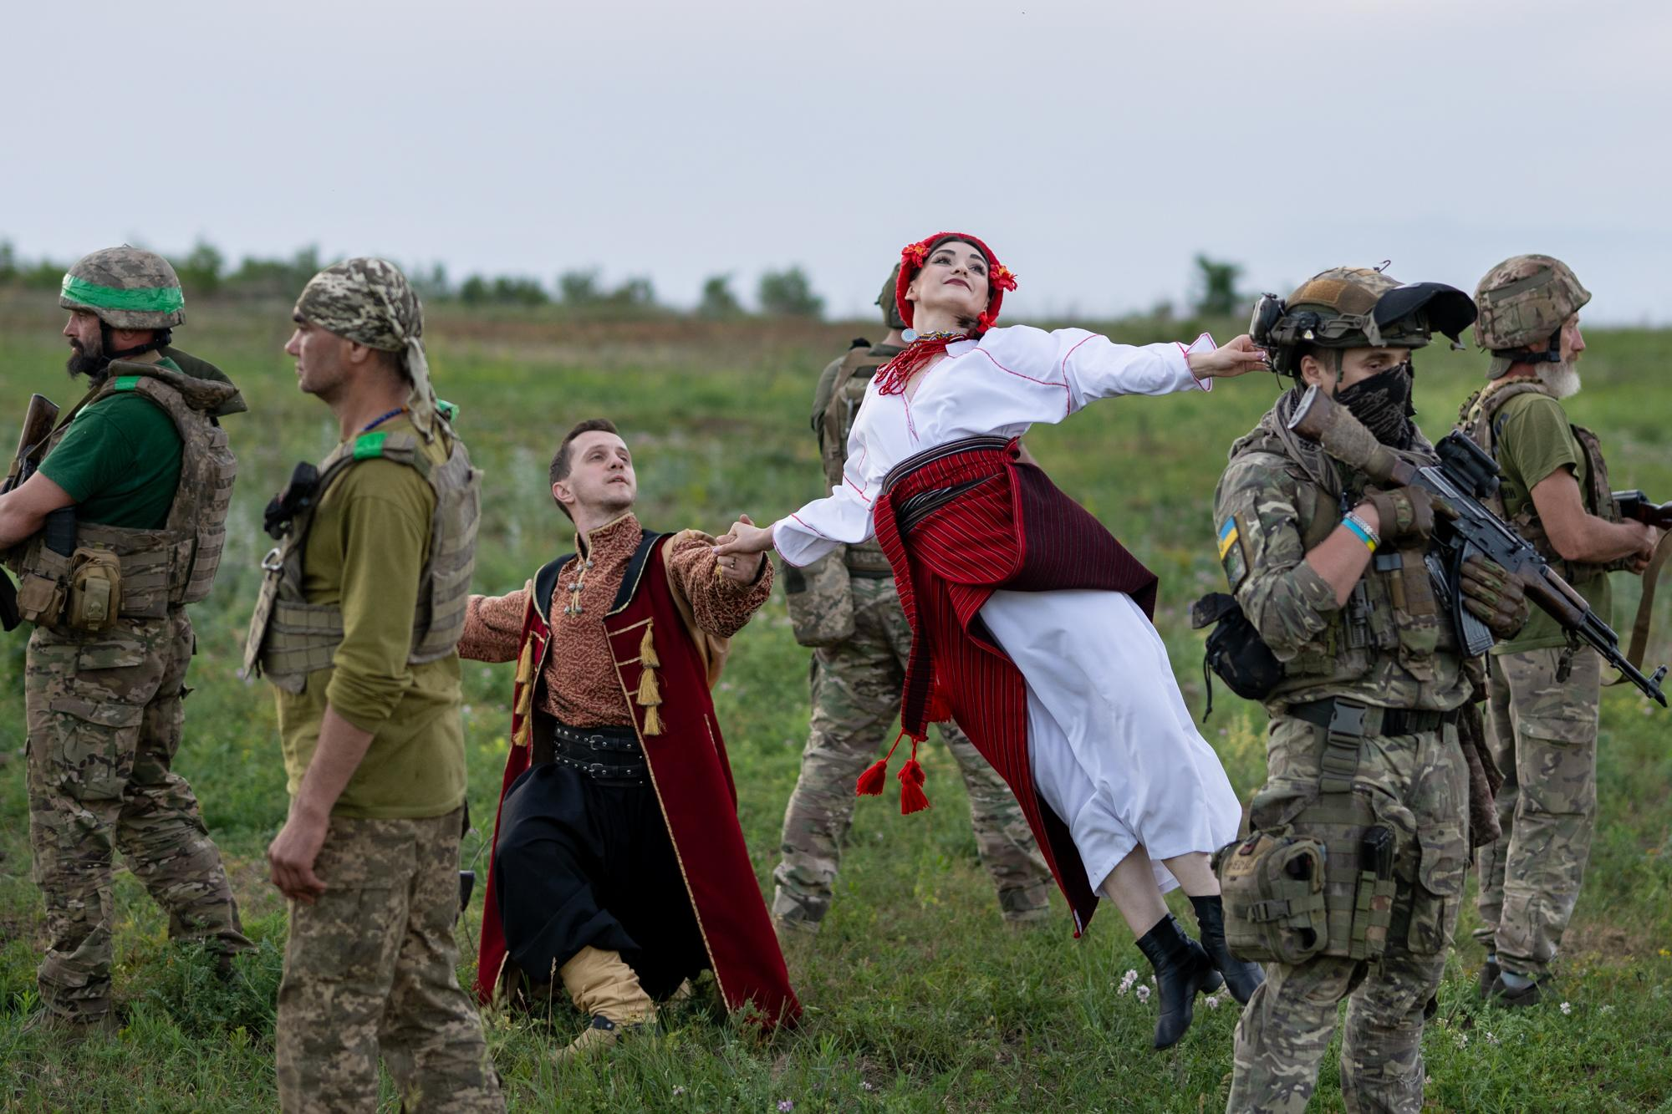
HOW WE HELP
Resources for Fundraising.
We want to make your journey as smooth as possible. We will help you with materials to make your event a success.
Customisable flyers, posters, invites, and social media templates
Ukrainian Patriot branding kits (logos, colour codes & usage guides)
Personal contact for support
UKRAINIANPATRIOT.ORG

Slide 8
WHAT YOU RECEIVE
This isn't a donation. It's a partnership.
When your studio joins the Frontline Dance Collective, you don't just raise funds — you join a network of studios, schools, and dancers building something that lasts.
01
A direct line to Ukraine's dance community
02
Exclusive online workshops from around the world
Access to workshops led by dancers across the globe — new styles, new perspectives, new inspiration for your students and teachers. Members only.
Your studio gets connected with dance schools in Ukraine — their stories, their resilience, their work. Not a video. Not a newsletter. A real relationship between your students and theirs.
03
Co-design limited edition merchandise
04
Early access to Resilience Camps & exchanges
Work with us to create exclusive Frontline Dance Collective pieces carrying the FDC message together with your studio’s emblems
Frontline Dance Collective members get first access to assist at our Resilience Camps and take part in future cross-border programmes — before anyone else.
UKRAINIANPATRIOT.ORG

Slide 9
Your Fundraising Helps
FEED FAMILIES
SUPPORT OUR MOVEMENTS
DELIVER LIFE-SAVING FIRST AID
$25 USD
$100 USD
$150 USD
This feeds a family of four with one of Ukrainian Patriots’ food bags. In 2025 youк support helped us deliver over 3,000 food bags to frontline and liberated communities.
This funds a tank of fuel to keep us moving to frontline communities to deliver aid, one of our resilience session, light, love, hope, connection.
This supplies critical tools in the form of IFAKs (Individual First Aid Kits) to combat medics under constant threat. These compact kits provide an additional window of time before help arrives.
PROTECT FRONTLINE LIVES
GIVE CHILDREN A BREAK FROM WAR
RETURN BALANCE
$250 USD
$500 USD
$1000 USD
This provides a small powerstation to charge devices necessary to remain in connect at zero line, where connection is the difference between life and death.
This sponsors a child to attend a week at camp at the UP Resilience Centre, including food, accommodation and emotional support.
This supports three resilience sessions frontline communities: our movements to location, materials, and small treats to leave with the children.
UKRAINIANPATRIOT.ORG

Slide 10
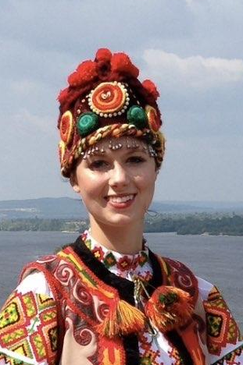
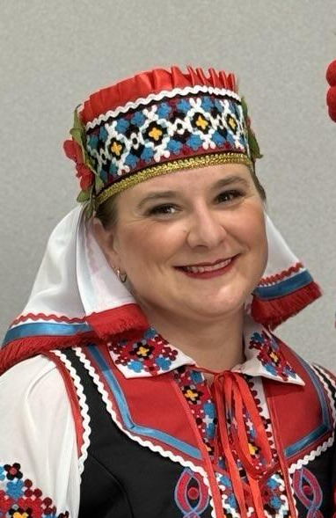
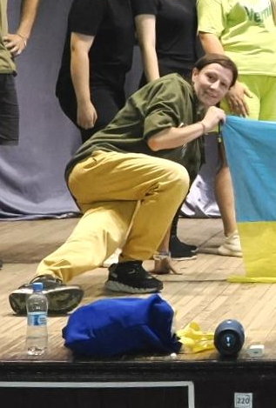
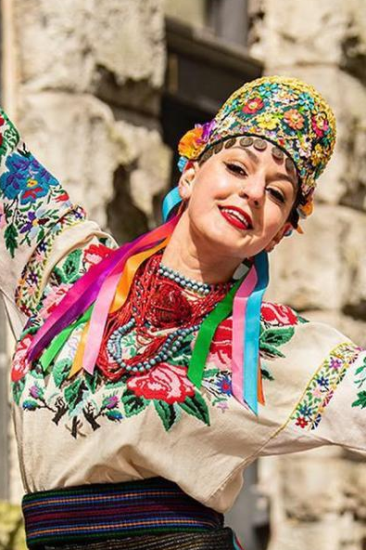
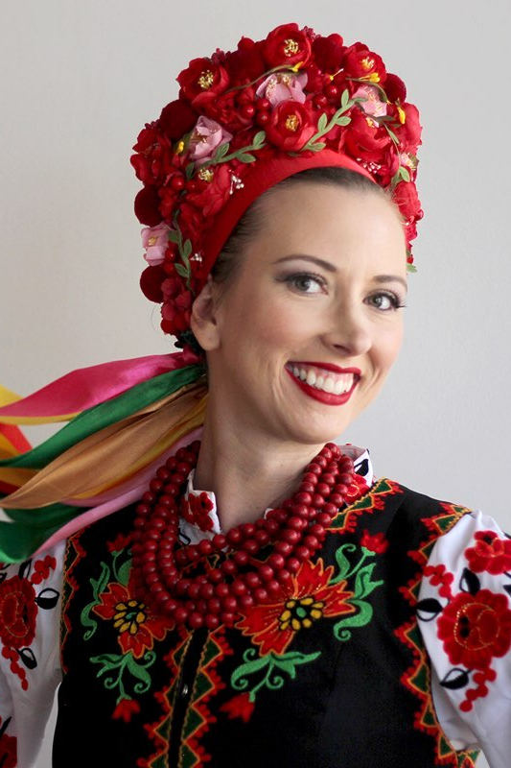
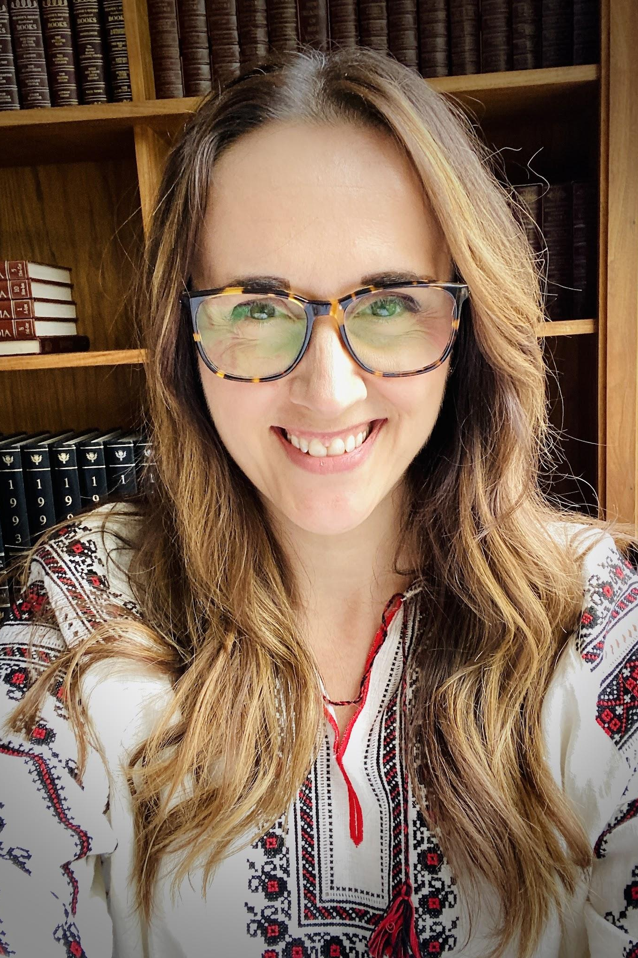
WHY NOW, WHY YOU
Ukraine is still fighting for its survival.
Homes have been destroyed, families displaced, and culture itself is under attack. Amid the chaos, we protect more than land — we protect our people, our identity, and the right to joy.
Many of our team members, from our founder to warehouse volunteers to frontline aid workers, are dancers who have swapped the stage for the humanitarian frontlines. We have never stopped believing in the power of rhythm, movement, and community.
Dance schools around the world are more than performance groups — you are guardians of culture, builders of identity, and now, partners in healing.
UKRAINIANPATRIOT.ORG

Slide 11
Take your first step today.
Your dance community can start tomorrow. Once you choose your month, we'll send you your fundraising toolkit, social media pack, and stories from the field to inspire your dancers and audience.
Together, we rebuild.
Together, we rise.
Together, we are Ukrainian Patriot - grounded in light, love, hope and connection.
ukrainianpatriot.org/frontline-dance-collective
dance@ukrainianpatriot.org
UKRAINIANPATRIOT.ORG

